Slide 1


DETECTION OF COVID-19 USING CHEST X-RAY IMAGES

Slide 2


MEET THE TEAM
ADITYA RANJAN
ABHAS GUPTA
AKUL BHARDWAJ
DEEPTANSHU PANTHI

Slide 3
INTRODUCTION TO PROJECT
01

Slide 4
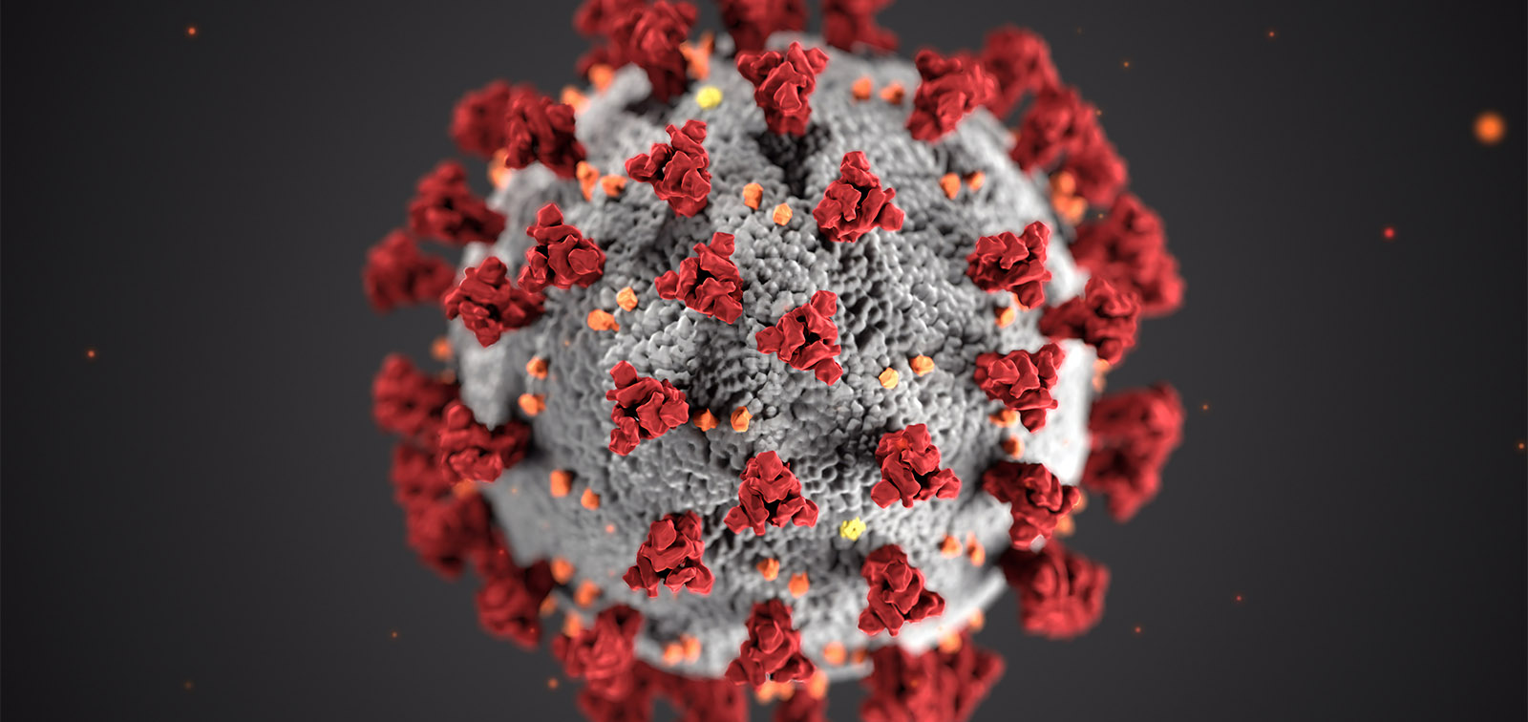
What Is COVID-19?
SARS-CoV-2 is a coronavirus that causes coronavirus disease 2019 (COVID-19).
Coronaviruses are a family of viruses that target and affect mammals’ respiratory systems.
SARS-CoV-2 mainly seems to travel from person to person.
SA.

Slide 5
How does Coronavirus Spread?
The virus is spread through respiratory droplets produced by an infected person through coughing and sneezing or by touching surfaces with the virus on them.
You can be infected by breathing in the virus if you are within close proximity of someone who has COVID-19, or by touching a contaminated surface and then your eyes, nose or mouth

Slide 6
Proposed Problem Statement
02

Slide 7

COVID-19 DETECTION USING CHEST X-RAY
MOTIVATION
Covid-19 detection is still not completely figured, as false negatives on test, raise question about inaccuracy.
To remove this inaccuracy in detection we came up with idea of detecting covid-19 using chest x-ray images through deep learning and neural network process.
We aim to achieve maximum accuracy level ranging from 95%-98%.

Slide 8
How Could Covid-19 Be Detected In X-Ray Images?
X-ray images as doctors frequently use X-rays and CT scans to diagnose pneumonia, lung inflammation, abscesses, and/or enlarged lymph nodes.
Since COVID-19 attacks the epithelial cells that line our respiratory tract, we can use X-rays to analyze the health of a patient’s lungs.

Slide 9
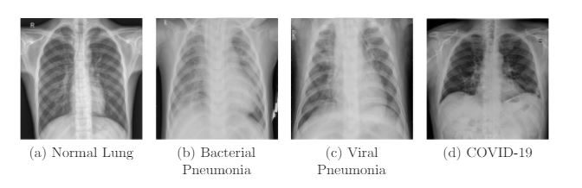
Examples Of Chest X-Rays
Bacterial pneumonia shows consolidation of the right lower lobe.
Viral pneumonia shows patchy consolidation in the right middle and lower zone
COVID-19 shows patchy ground-glass opacity in the Left Lower Zone

Slide 10
Advantages Of Using X-Ray
It is more widespread and cost eﬀective than conventional diagnostic tests.
It makes the diagnostic process extremely quick.
Unlike CT Scans, portable X-Ray machines also enable testing within an isolation ward itself, hence reducing the requirement of additional personal protective Equipment (PPE)
It reduces the risk of hospital-acquired infection for the patients

Slide 11
OBJECTIVES OF OUR PROJECT
03

Slide 12
1.To collect maximum data in terms of chest x-ray images from various reliable sources for training our model.
2.Using this dataset to train our model and perform image classification using CNN to detect covid-19 infected patients .
3.Evaluate performance of our CNN model by finding accuracy rate.

Slide 13
LITERATURE REVIEW
04

Slide 14
RESEARCH QUESTIONS
Which Convolutional Neural Network architecture is best suited for Covid-19 Detection ?
What is difference between Resnet50 and VGG16 Model?
What is the main objective of Covid-19 detection using chest x-ray ?

Slide 15
RESEARCH FINDINGS
Xception model is best suited for Covid-19 detection as it is 71 layers deep cnn architecture with accuracy 97%-98% .
VGG16 is 16 layers deep cnn model whereas Resnet50 is 50 layers deep cnn model.Computing time of VGG16 is faster that of Resnet50.
Main objective of Covid-19 detection is to achieve at most possible accuracy even if the processing time is high as human life depends on it.

Slide 16
WORKING OF PROJECT
05

Slide 17
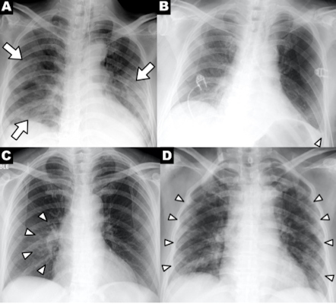
1.CLONING AND EXPLORING IMAGE DATASET
We will be cloning the dataset of covid patients and non covid patients to the colab platform and exploring the structure of cloned dataset.

Slide 18
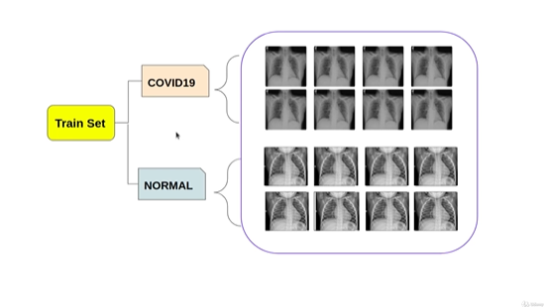
2.Image Visualization
Image Visualization will be performed on train set of covid and non covid patients to see how our data sets look like.

Slide 19
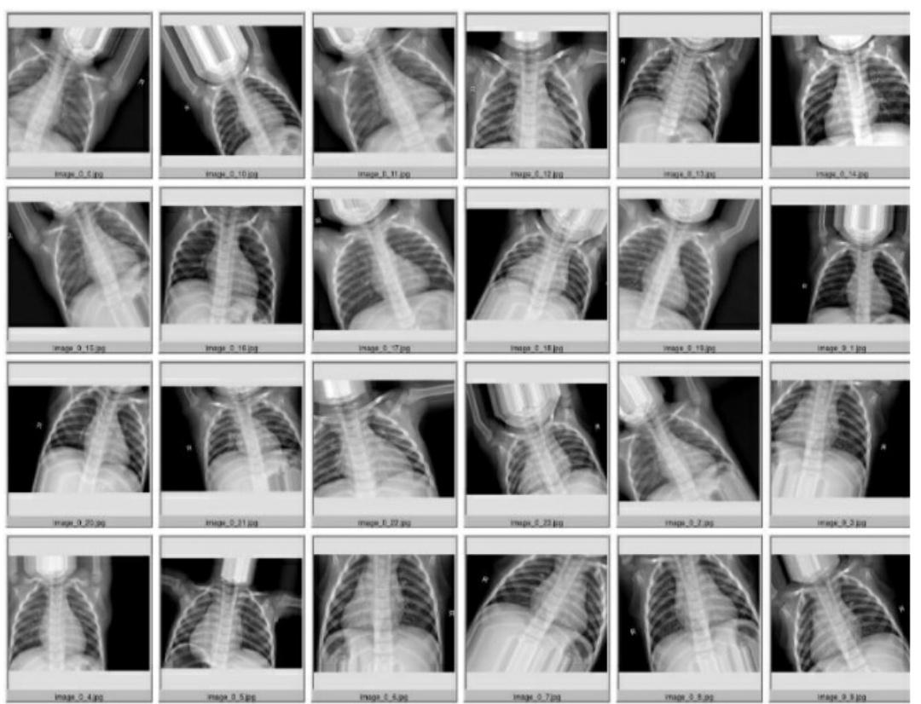
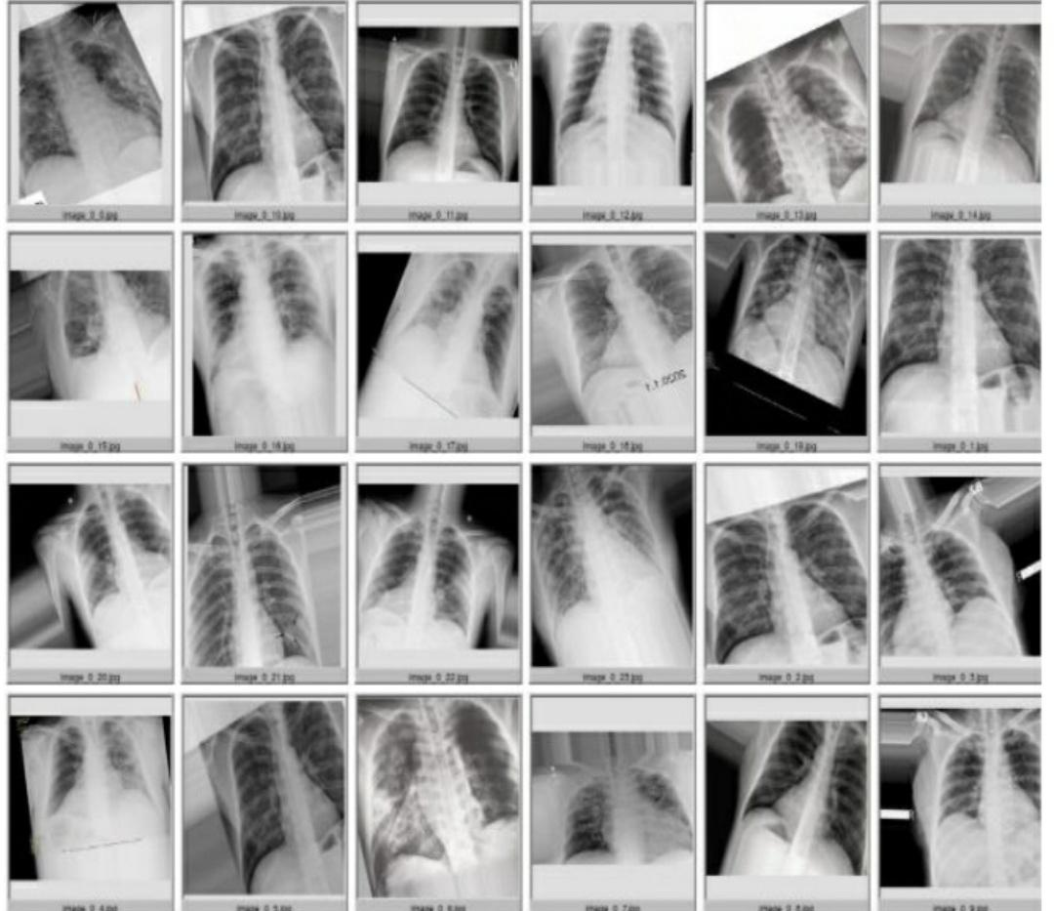
3.Image Augmentation
We will perform some image augmentation to increase the size of training set with some zooming and horizontal flip features of the images.

Slide 20
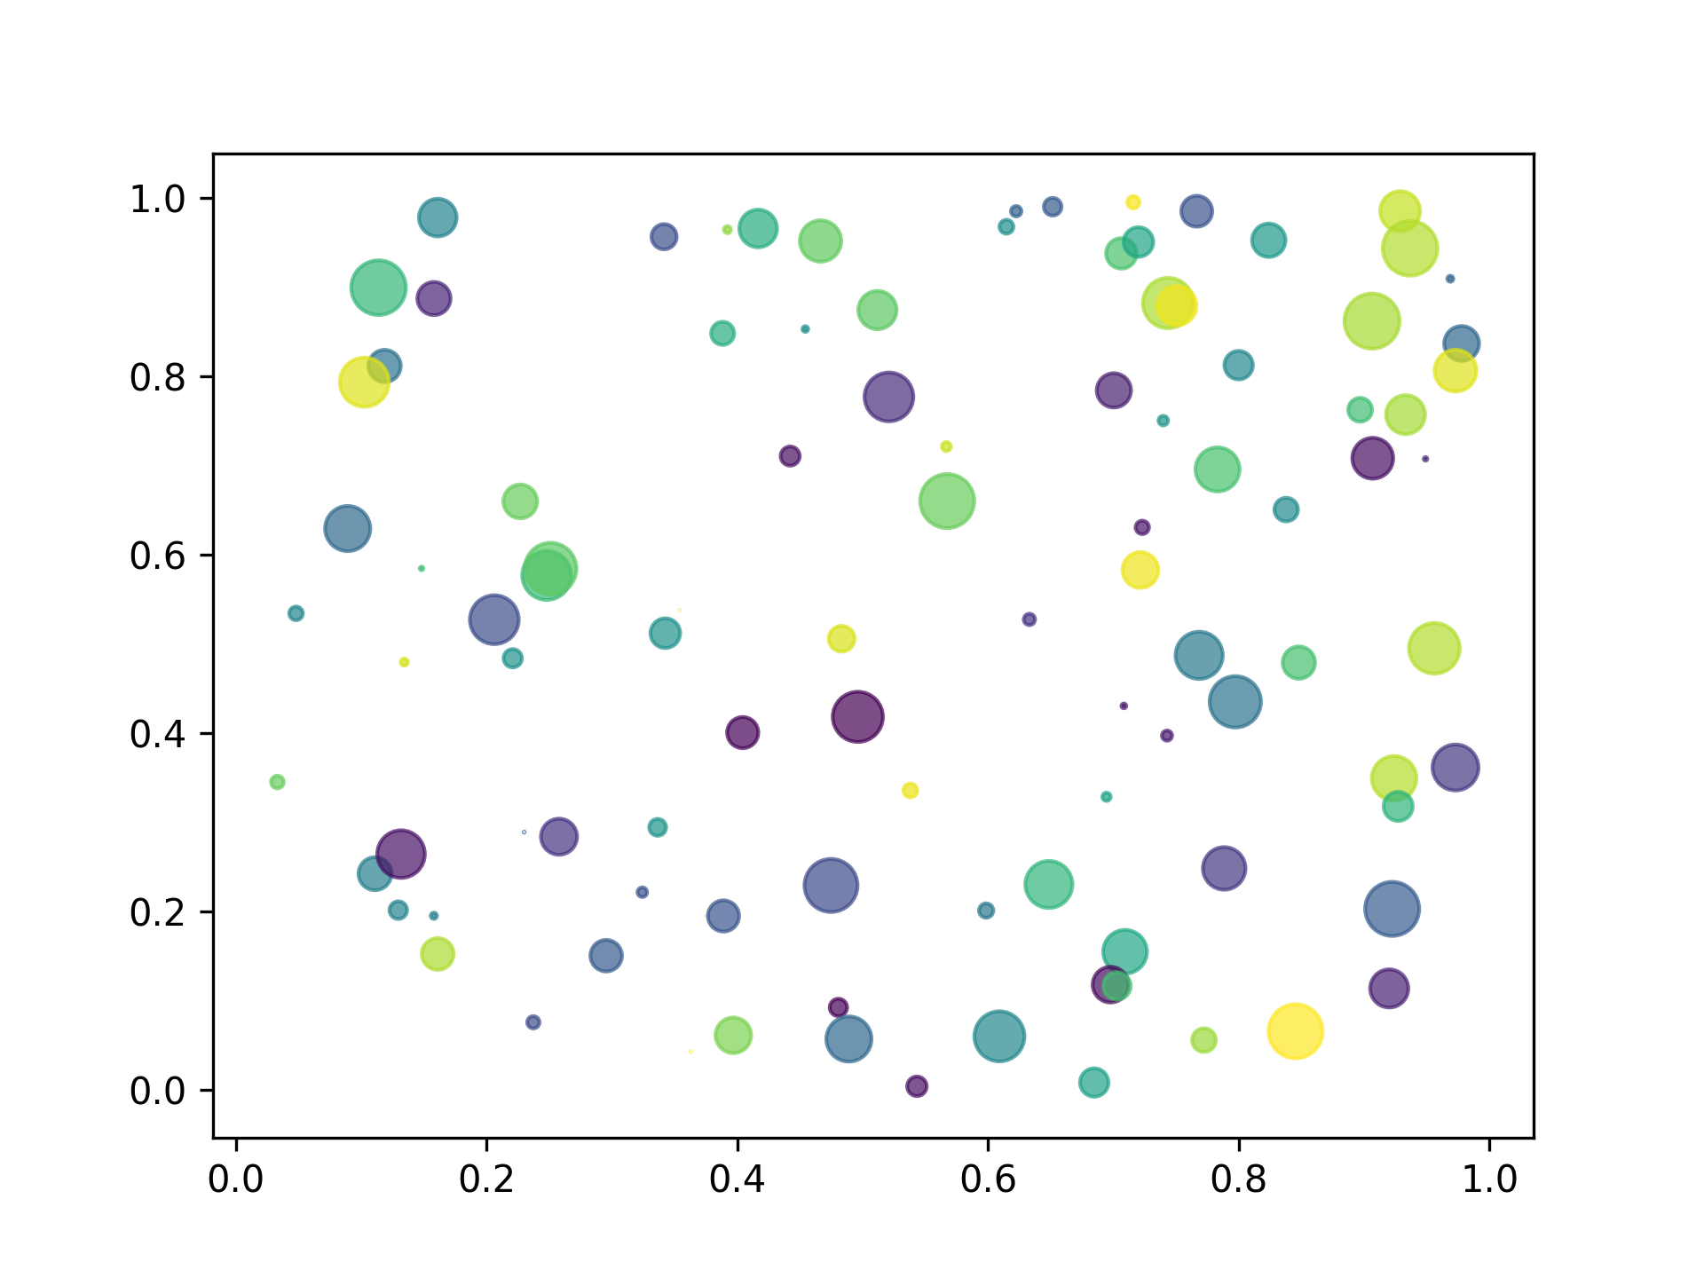
4.Image Normalization
We will be normalizing the pixel value between 0 and 1.

Slide 21

5.Building CNN Model
Convolutional Neural Networks is one of the main categories to image recognition, image classification, object detection and recognition phases. CNN image classification take an input image, process it, classify it under certain categories.

Slide 22
6.Training and compiling of CNN model
Compilation of CNN Model will be executed and training will be completed.

Slide 23
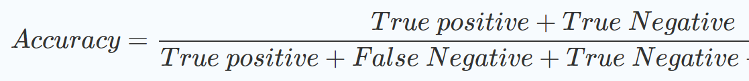
7.Performance evaluation and test model
Evaluating the performance of model and plot two different graphs for training and validation loss and training and validation accuracy to see how are model performs during the training phase. We will test our model with testing data set and then will finally save our model to the disk.

Slide 24
SOFTWARE REQUIREMENT
06

Slide 25
HARDWARE TOOLS
Hardware Tools : -
● CPU: - Intel CORE i5 8th Gen (Clock speed: - 2.8 GHz)
● GPU: - NVIDIA GEFORCE MX150 (4GB VRAM)

Slide 26
Software Tools
● Scikit-learn
● Keras
● NumPy
● Pandas
● matplotlib
● Operating System: - Windows 10
● Scripting Language: - Python
● Platform : Google Colab

Slide 27
RELEVANCE OF OUR PROJECT
07

Slide 28
Saves financial expenditure on medical tests and services.
Saves time by fast detection on large datasets.
Easily accessible for everyone .
Less chance of human error and more efficient.

Slide 29
CONCLUSION
The rapid spread of COVID-19 across the world and the increasing number of deaths require urgent actions from all sectors.Detecting covid-19 at large scale would help determining the infected people so we can save more people who are prone to get affected.In future if similar kind of respiratory diseases appear which threatens to be pandemic,we will be ready with a solution.

Slide 30
REFERENCES
https://journals.sagepub.com/doi/full/10.1177/2472630320958376
. https://towardsdatascience.com/detection-of-covid-19-presence-from-chest-x-ray-scans-using-cnn-class-activation-maps-c1ab0d7c294b
https://link.springer.com/article/10.1007/s10489-020-01902-1

Slide 31

THANK YOU

